Slide 1
Shell Bootcamp 2024 3 Reflections for Week #1
Priadarshni Muthukumar
Date : 30-Aug-2024

Slide 2

About Me
The Harder you work for something, the greater you feel when you achieve it.
Please share an image / visual that best represents you

Slide 3

My learnings from this week!

Slide 4
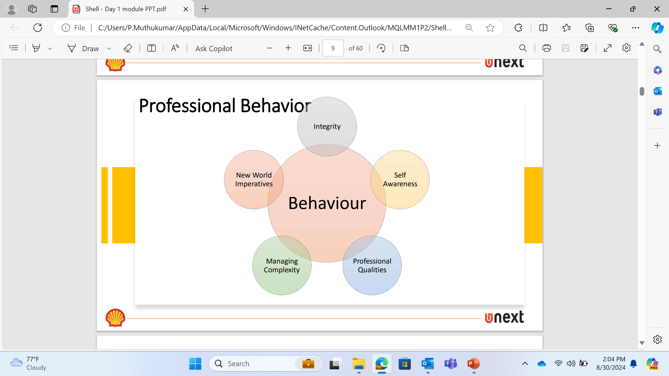
Learning 1 | My takeaways
To begin with, I learnt about the importance of professionalism and various elements (punctuality, behavior, growth mindset honesty, responsibility, integrity and effective communication) associated with it.
Business Etiquette (including grooming) and Email Writing were two of the most important key takeaways in this learning.
Being in a workplace, I think its necessary to upheld all the values/skills listed above for a safe and healthy working environment.
[Add a graphic that provides evidence of what you learned]

Slide 5
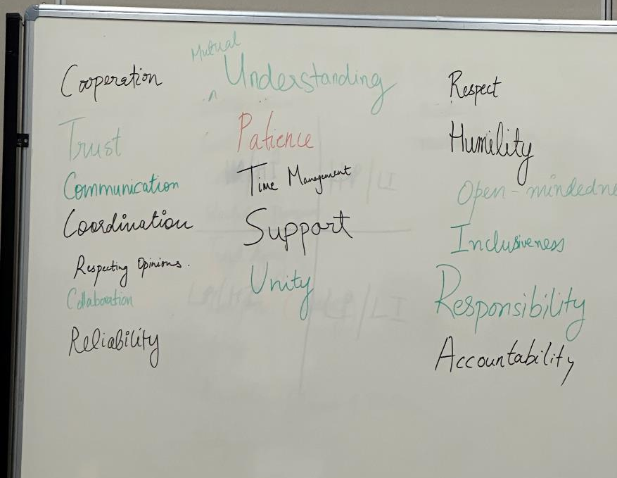
Learning 2 | My takeaways
Stakeholder Management was one of the key concepts learnt. It includes different processes namely- Identifying Stakeholders, Plan Stakeholder Management, Stakeholder Engagement and Control Stakeholder engagement.
We also learnt about the importance of teamwork. These are important as we will be working in teams during project developments.
Working in real-time projects stakeholder management, a very crucial learning. It helps to understand and approach the stakeholders in an efficient manner and fulfil their requirements.
[Add a graphic that provides evidence of what you learned]

Slide 6
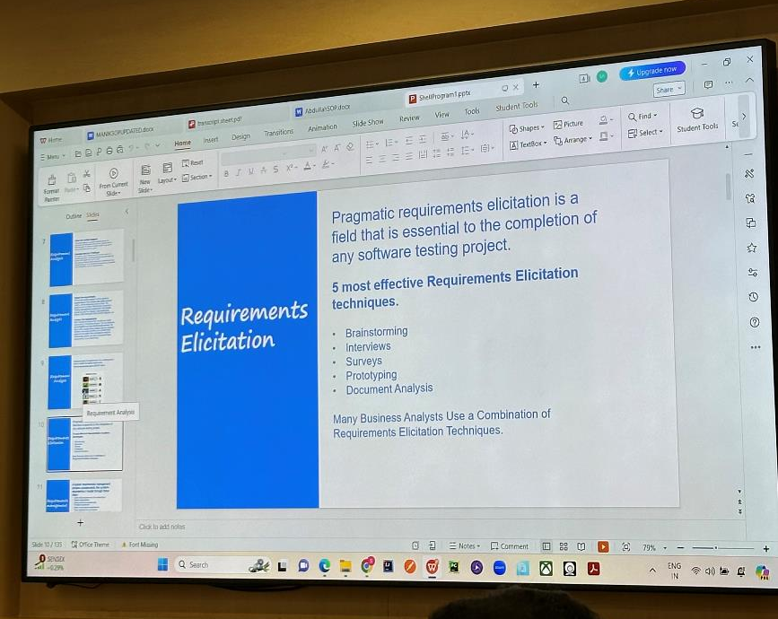
Learning 3 | My takeaways
During the technical Bootcamp, I learnt about the functions of a Business Analyst (BA). The BA acts a medium of communication between the client and the developers.
The BA who have both Functional and Technical knowledge are called Product Owner (PO).
Next, I learnt about the Software Development Life Cycle (SDLC) and the various processes involved in it.
These concepts will help in developing projects and understanding the stages of project development.

Slide 7

Relevance of learnings for my organization

Slide 8
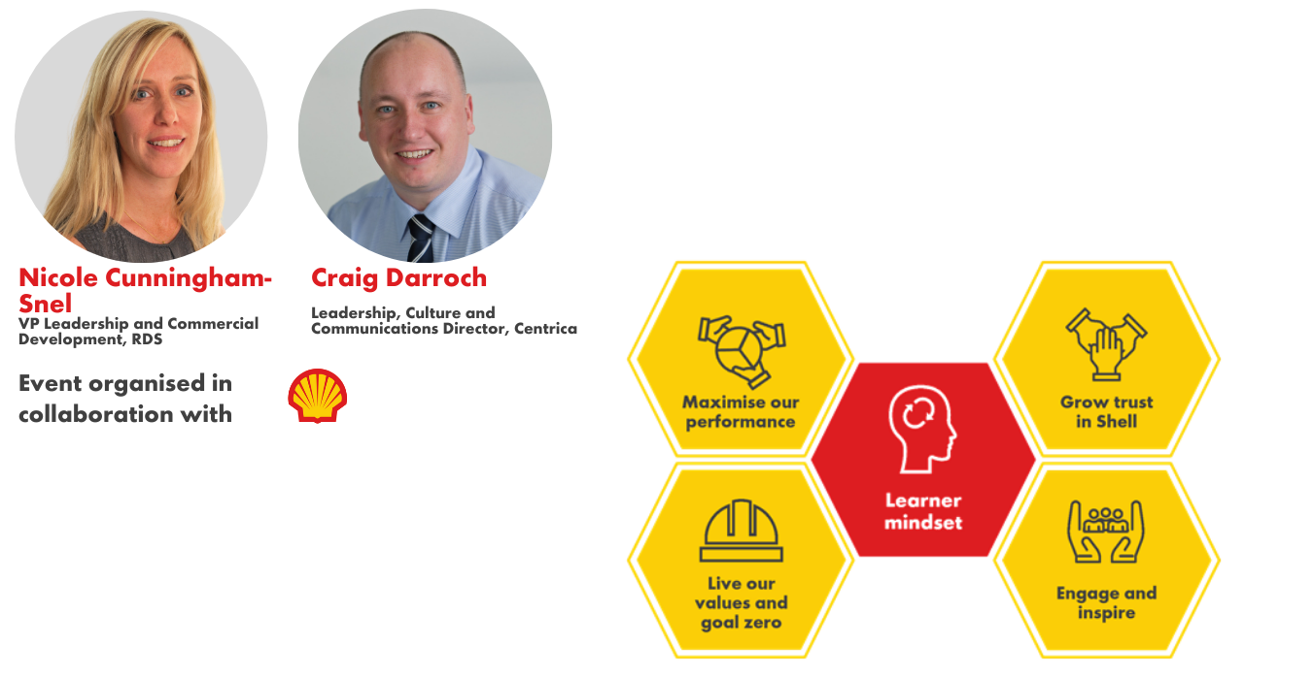
Learning 1 | Relevance for Shell
How I feel Shell implements this learning
Shell encourages to always follow professional behavior in the workplace. Having a growth mindset is a concept shell encourages among everyone who are a part of the organization. Shell also believes that effective communication is key to success of oneself and the organization.
How I feel Shell benefits from this learning
Growth mindset in an individual makes him learn quicker and work smarter. This not only improves their personal growth but also the company’s progress.
[Add a graphic that provides view of how Shell implements this learning]

Slide 9
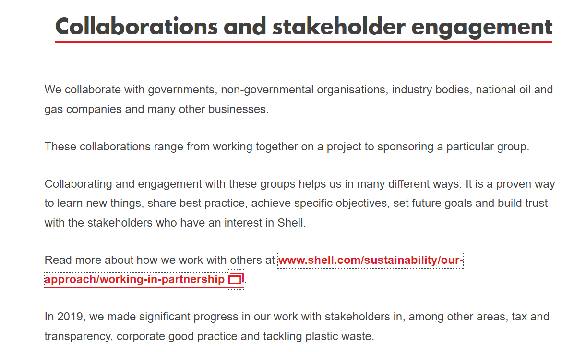
Learning 2 | Relevance for Shell
How I feel Shell implements this learning
Shell, which have millions of stakeholders, understands the importance of stakeholder management and works towards satisfying their expectations. It also conducts multiple programs and workshops to keep everyone updated on this concept.
How I feel Shell benefits from this learning
Effective stakeholder management and healthy teamwork not only helps in proper completion of the project but also increases the overall performance of the company.
[Add a graphic that provides view of how Shell implements this learning]

Slide 10
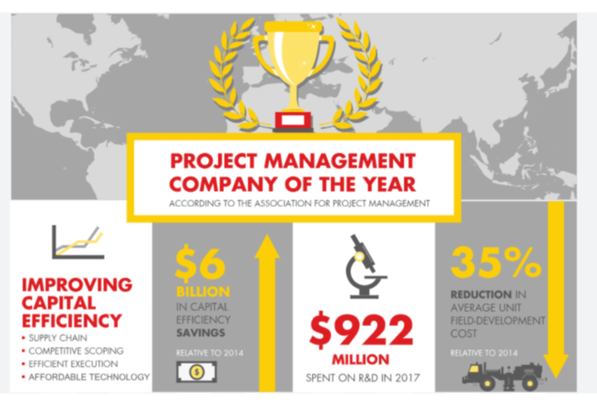
Learning 3 | Relevance for Shell
How I feel Shell implements this learning
The teams in Shell, follow the SDLC life cycle processes while developing their project. The Sprint agile framework is the most used SDLC model. Therefore, it is implemented by most of the teams working on a project.
How I feel Shell benefits from this learning
This form of development is highly efficient and client interactive, hence, it contributes to systematic project development and client requirements/changes can be easily accommodated.
[Add a graphic that provides view of how Shell implements this learning]

Slide 11

Challenges in implementing learning

Slide 12
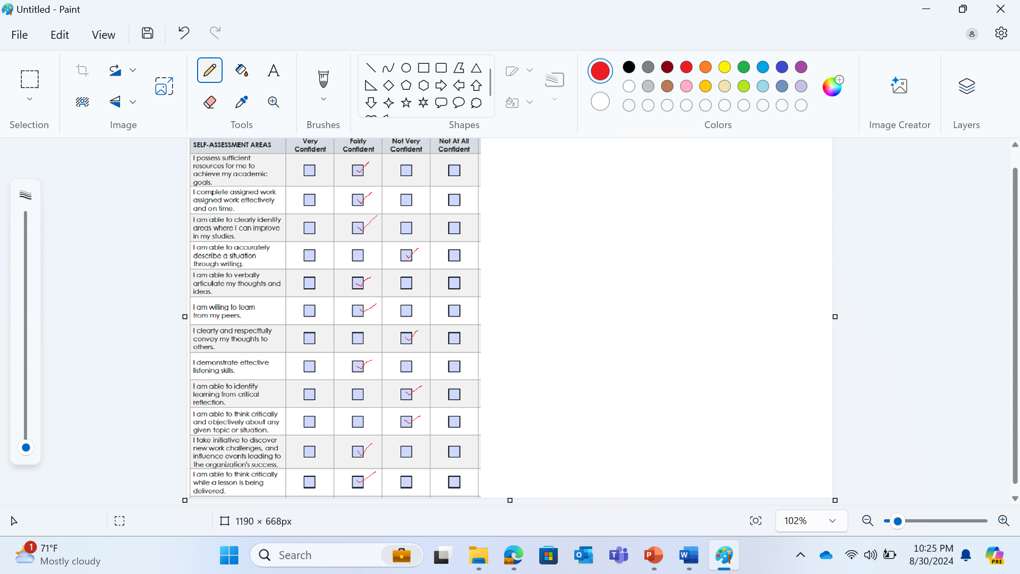
Challenge faced while implementing Learning 1
The most common challenge I faced in while understanding Professionalism was effective Communication. I had difficulty in speaking without grammatical errors in front of unknown people. In order to overcome them I spent atleast one hour in improving my speaking. I noted down my weak points through self assessments and tried to work on those specifically.
Priadarshni2112/Shell-Bootcamp (github.com)

Slide 13
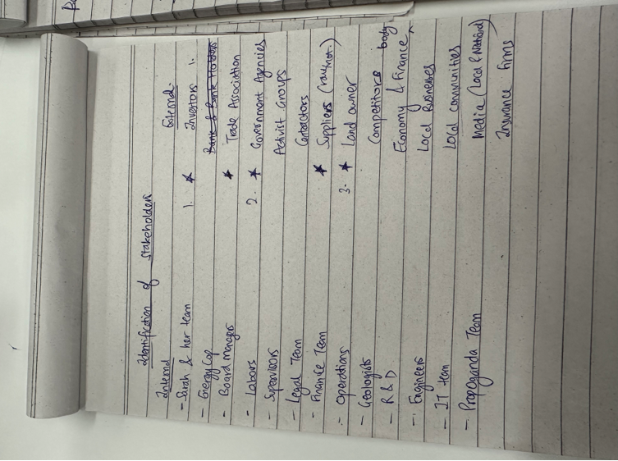
Challenge faced while implementing Learning 2
Understanding the exact number of stakeholders and the priority of stakeholders was one the challenge I faced while learning about Stakeholder management. To overcome this, I analyzed multiple case studies and problems to identify the correct stakeholders and classify them accordingly.
Priadarshni2112/Shell-Bootcamp (github.com)

Slide 14
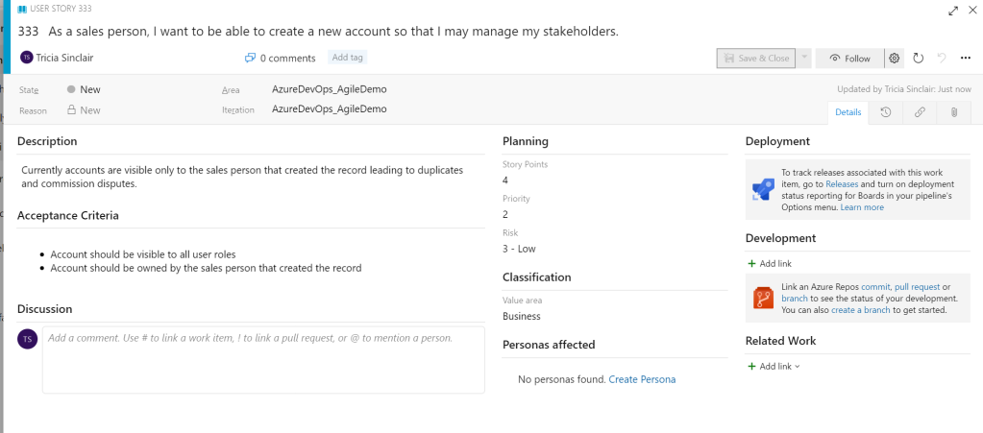
Challenge faced while implementing Learning 3
The challenge I faced while understanding the Sprint Agile Model was how sprints are formed from user stories and built in parts by the developers. To overcome this challenge, I tried to observe the Azure DevOps and story backlogs and note down the various steps/descriptions involved in its creation.
Priadarshni2112/Shell-Bootcamp (github.com)
[Add a graphic that provides evidence of what you did to overcome this challenge]

Slide 15

Action Plan

Slide 16
My Action Plan for this Week
Actions
Timeline
Status
In this week, I will try to improve my communication skills by practicing business communication by practicing speeches and taking listening tests.
During group activities or meets, I will make sure to share my opinions in a respectful manner and ensure that all the members have equal contribution.
I will try to implement the BRD,SRS and Agile Model on the topic given.
Work on communication skills:1-2 hours everyday
Work on the Business Requirement Document (BRD): 3-4 hours
Software Requirement Specification document: 5-6 hours
Agile Sprint Model Implementation document: 5-6 hours
I was able to complete all the tasks/actions mentioned in week-1.

Slide 17

Learning is also Fun!

Slide 18
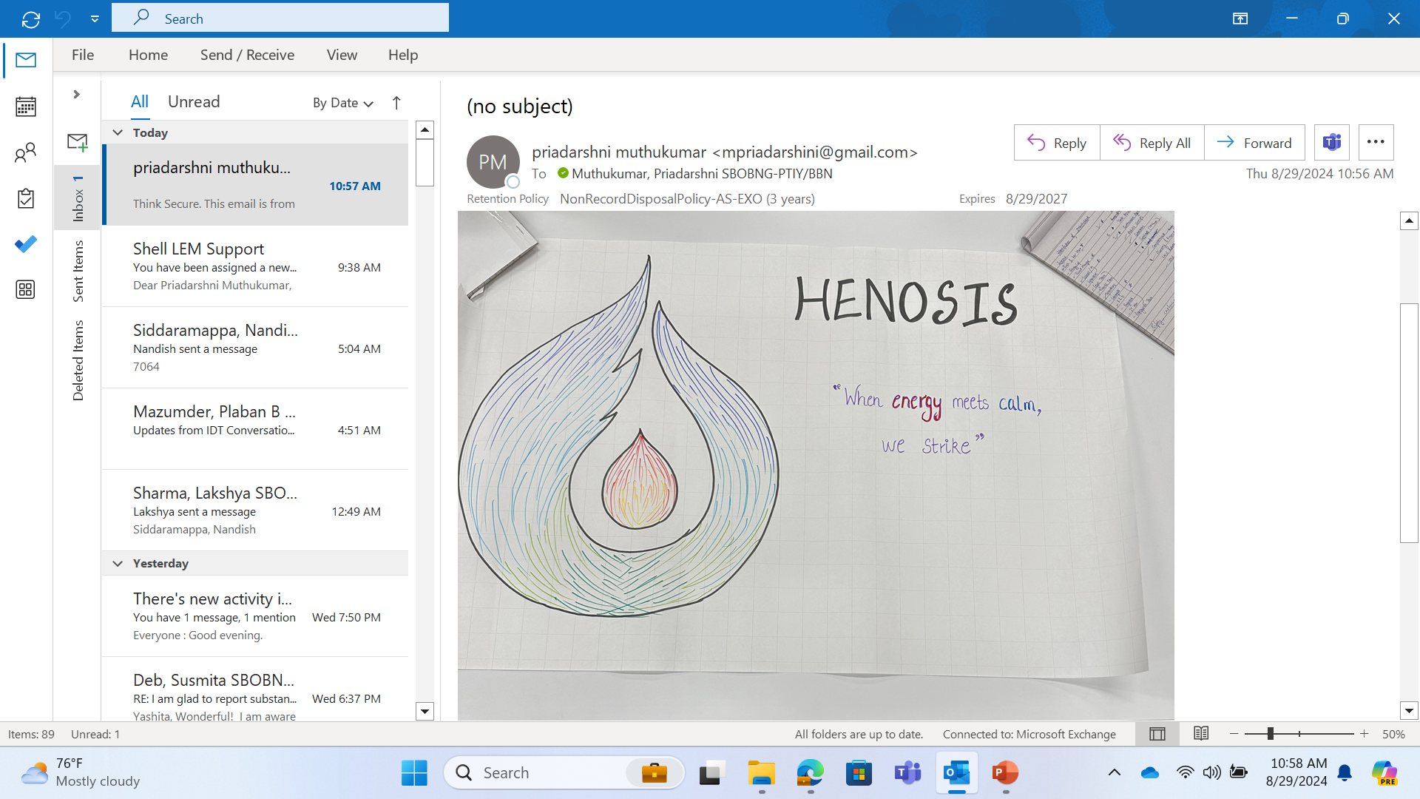
Learning is also Fun!
One of the group activity, which was fun and engaging was ‘logo making’, groups of 6 were formed and directed to create a logo along with a name and tagline that defines it.
The activity was creative and interactive, it helped to understand teamwork and effective communication.
Our group designed a logo depicting ‘fire and water’ as ‘unity’. The name of the logo is ‘HENOSIS’ which means ‘united’ or ‘together’.

Slide 19

Summary
At the end of week 1,under soft skills training, I was able to understand the importance of professionalism in a work environment. The various components in professionalism help to define ourselves as better individuals in a workplace.
Next, stakeholder management was one of the key learning from week 1. It helps to communicate better with the clients and understand their requirements and preferences.
Next, as a part of technical Bootcamp, I gained knowledge about Business Analyst functionalities, Software development lifecycle (SDLC), its stages and Agile framework, which is mostly followed during project development.
In the upcoming weeks, we will learn more about DBMS, Software Testing, DevOps and Cloud.

Slide 20
Thank You

